Slide 1
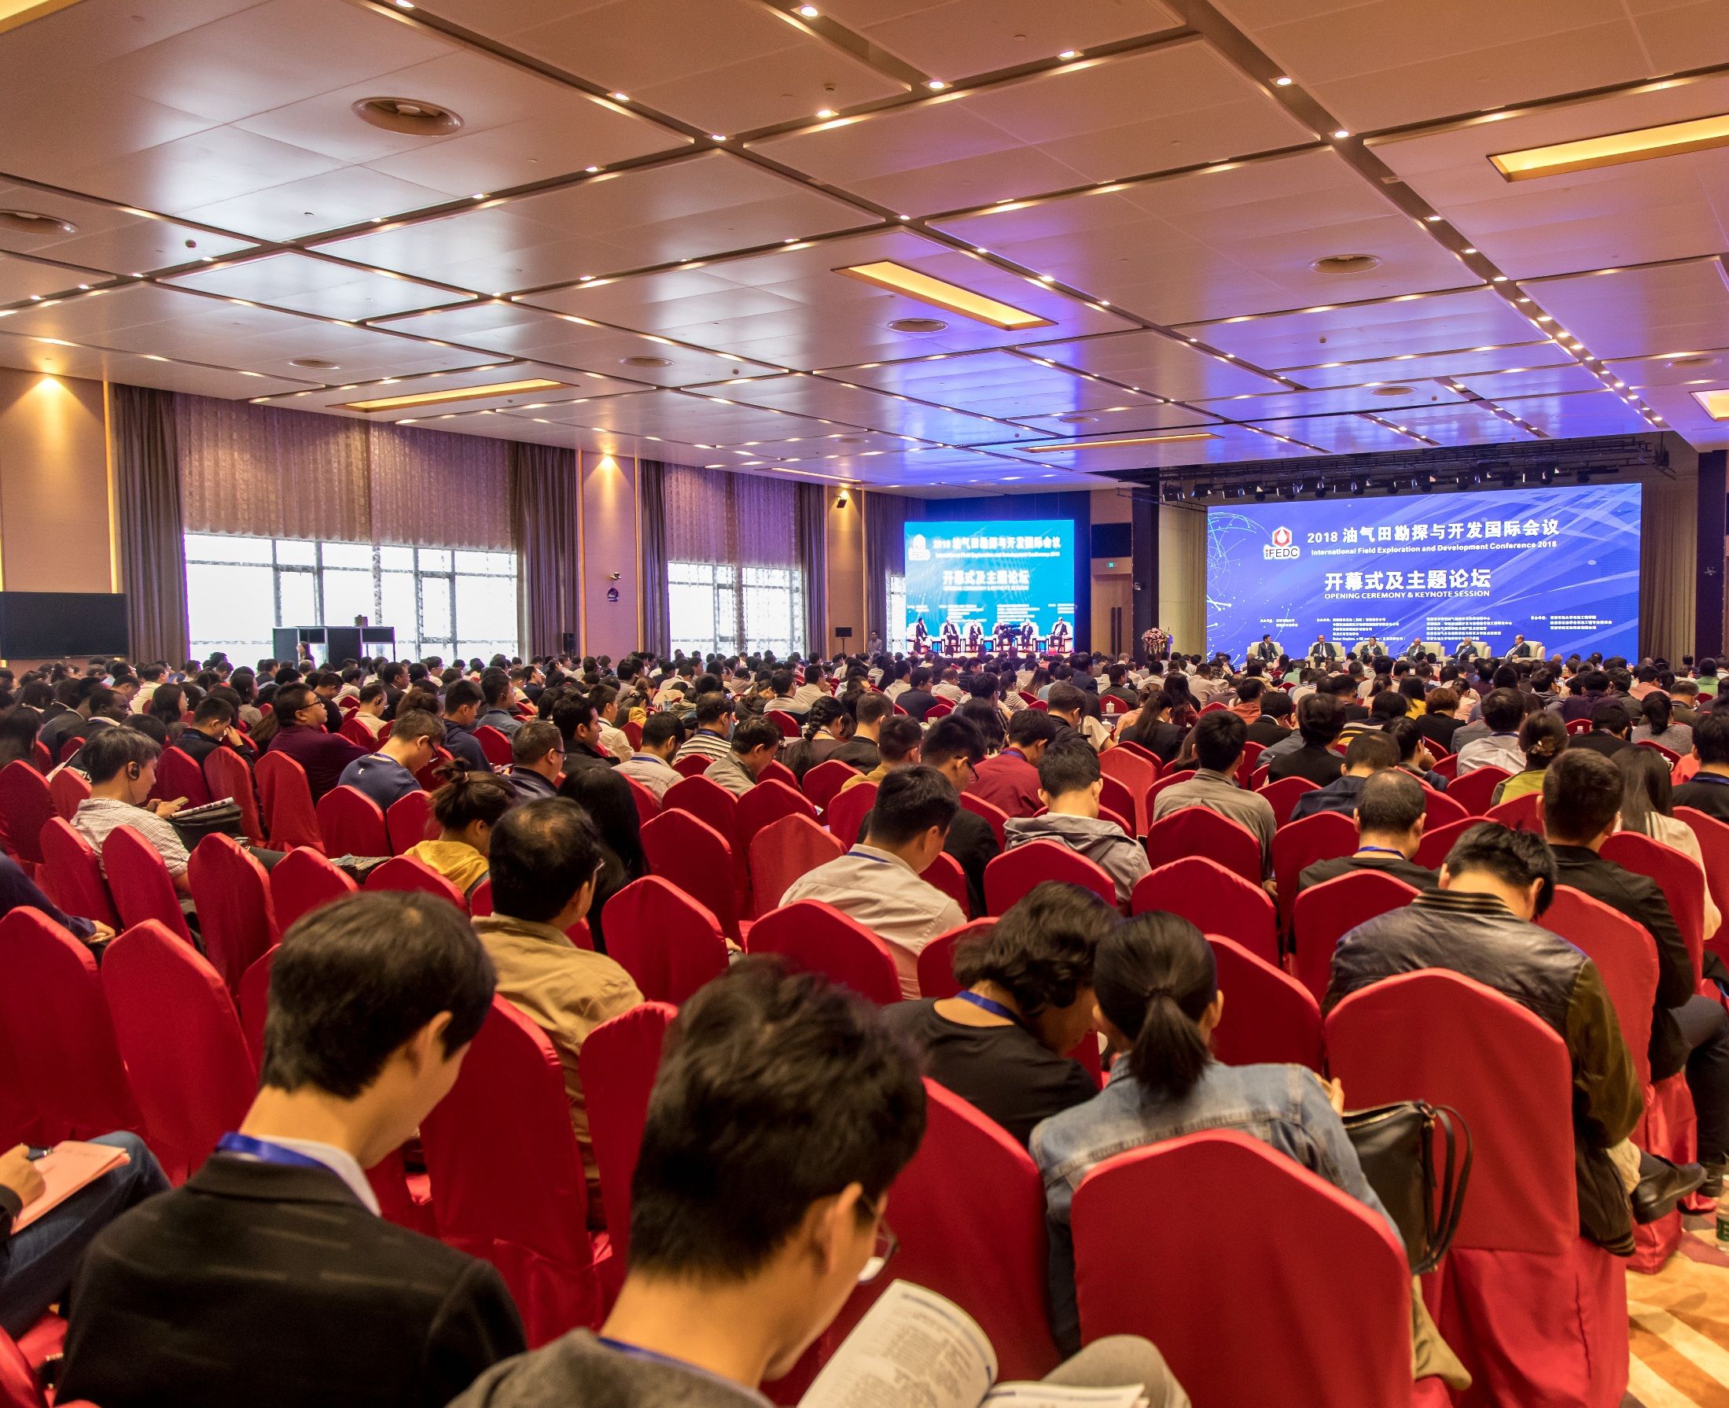

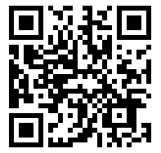
油气田勘探与开发国际会议
International Field Exploration and Development Conference
Sponsorship Plan
IFEDC Organzing Committee

Slide 2

Content
Conference Profile
Sponsorship Program
Exhibition IFEDC
1
2
3

Slide 3
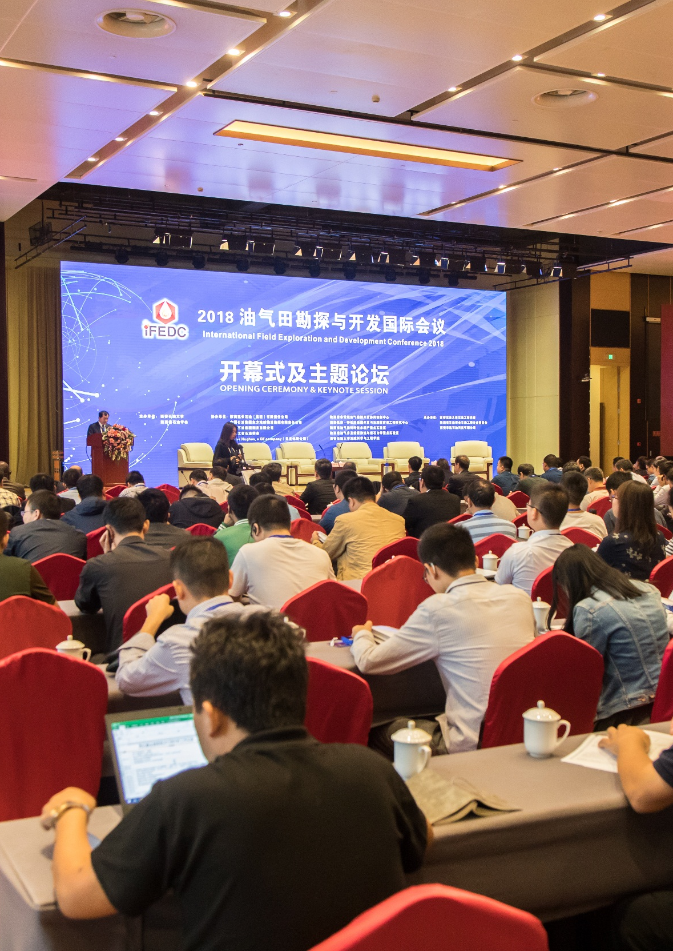
1
Conference Profile
>>>

Slide 4
Conference Profile
General information
Theme
Advanced Technologies for Driving the Future of the Energy Industry
Date
16-18, September 2026
Venue
Harbin ●China
Attendees
1800+
15%
Industry Leaders
+
45%
Experts & Scholars
+
30%
Senior Engineers
IFEDC Attendees

Slide 5








Conference Profile
IFEDC Topics
Session 1
Reservoir Surveillance
Technology
Session 2
Reservoir Evaluation &
Modeling Techniques
Session 3
Reservoir Dynamic
Description
&Management
Session 4
Drilling and EOR
Session 5
Ultra-Tight Reservoir
Development
Session 6
Unconventional Oil &
Gas Resources Technology
Session 7
Geomechanics
Session 8
Digital and Intelligent
Oil &Gas Fields

Slide 6
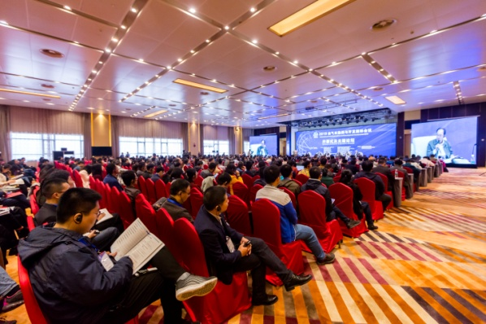
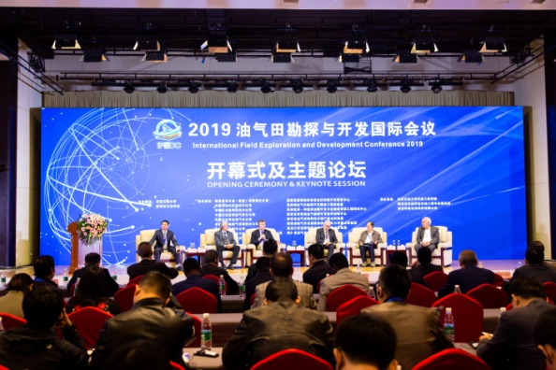
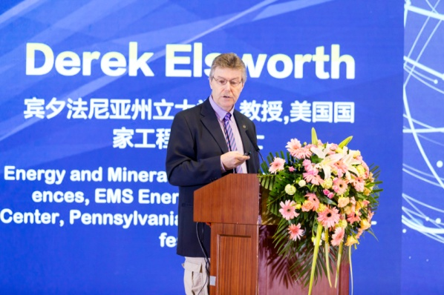
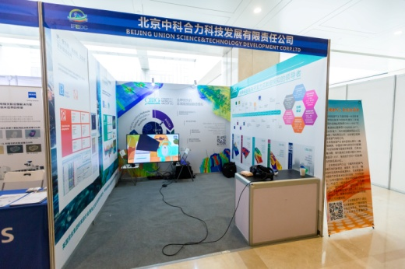
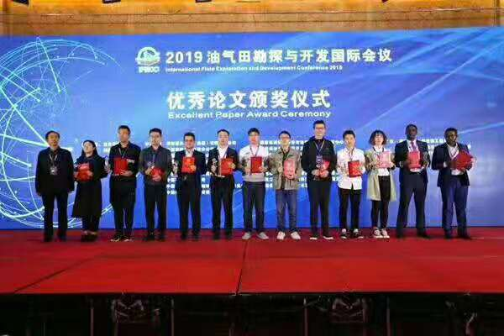
Conference Profile
IFEDC Program
Part 1
Opening Ceremony
Part 2
Panel Keynote Session
Part 3
Oral Presentation
Part 5
Technical Products
Exhibition
Part 6
Excellent Paper Award Ceremony

Slide 7
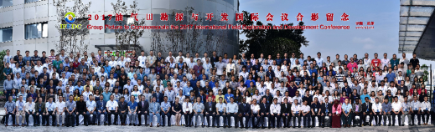
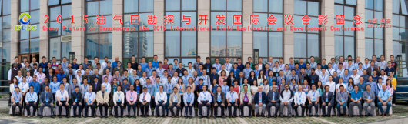
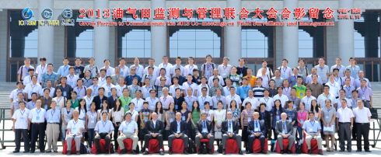

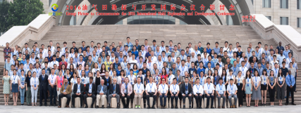
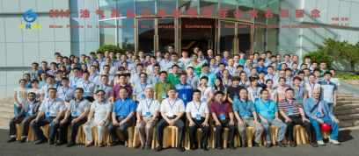
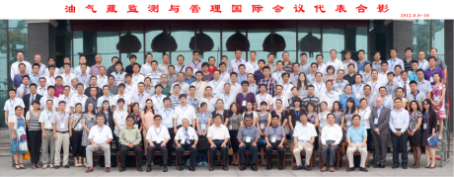
Conference Profile
IFEDC2017
IFEDC2015
2015
2017
ICRSM 2013
2013
ICRSM 2011
2016
2018
2014
IFEDC2016
IFEDC2018
2011
ICRSM 2014
2012
ICRSM 2012
Over the Past Decades

Slide 8
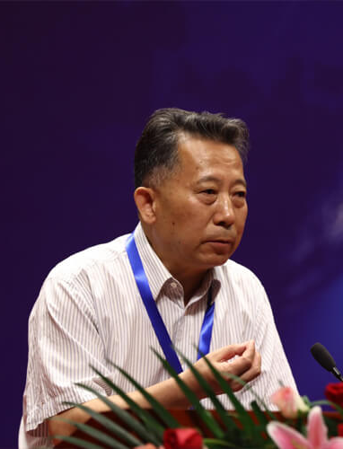
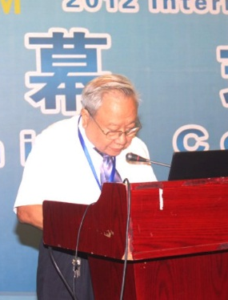
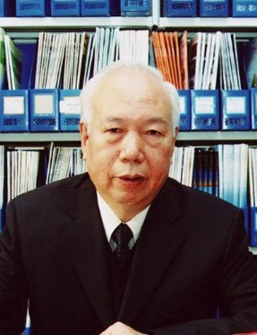
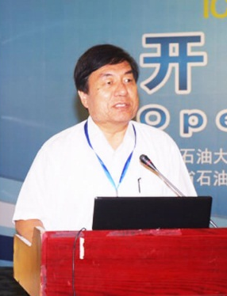
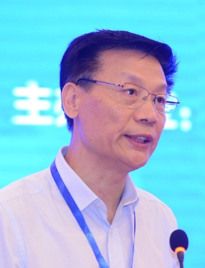
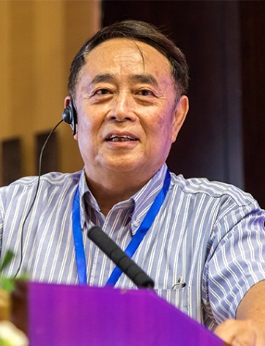
Conference Profile
Academician of the Chinese Academy of Engineering at IFEDC
The International Field Exploration and Development Conference (IFEDC) is designed for experts, engineers and geologists as well as executives from oil companies, service companies and academia who are interested in developing a cross-disciplinary perspective on increasingly complex oil and gas projects connected with exploration and development.
GAO De-li
HAN Da-kuang
LI He-lin
LI Yang
ZHAO Wen-zhi
ZHOU Shou-wei

Slide 9
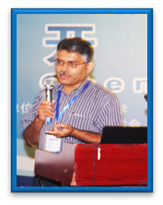
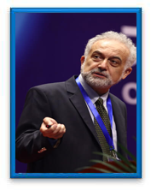
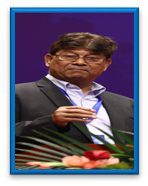

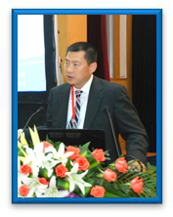
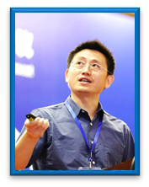
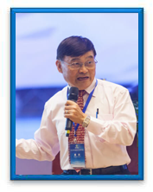

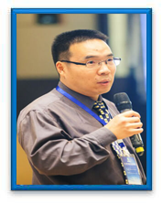
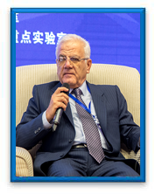
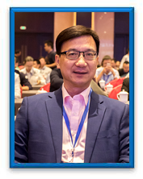
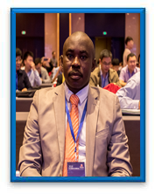
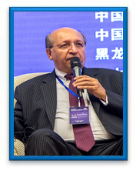

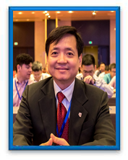
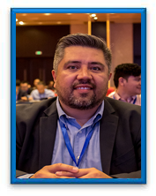
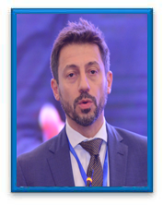
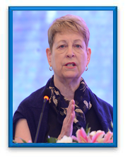
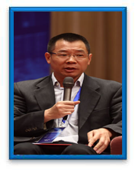
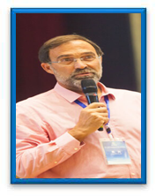
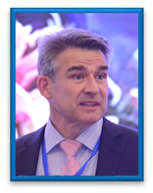
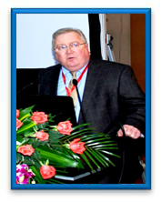
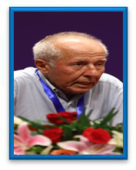
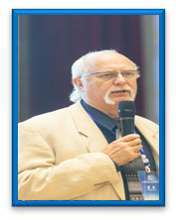
Conference Profile
Famous Speakers at Previous Events
S. Srinivasan
Tayfun Babadagli
Usman Ahmed
V.V.Kadet
Weidong Li
XIAN Cheng-gang
YU Bing-sen
Mr Yisen
ZHANG Tuan-feng
Alireza Bashari
Andrew Seto
Dare Jeremiah
Dr.Luis Quintero
Garry Ward
Minh V Vo
Miguel Angel
Maruri Carballo
Alessandro Ferretti
Christine Ehlig-
Economides
CHEN Xin-feng
André Baken
David Bowling
Dennis Dria
Dr. Fikri J Kuchuk
R. J. (Boo)
Boocock

Slide 10
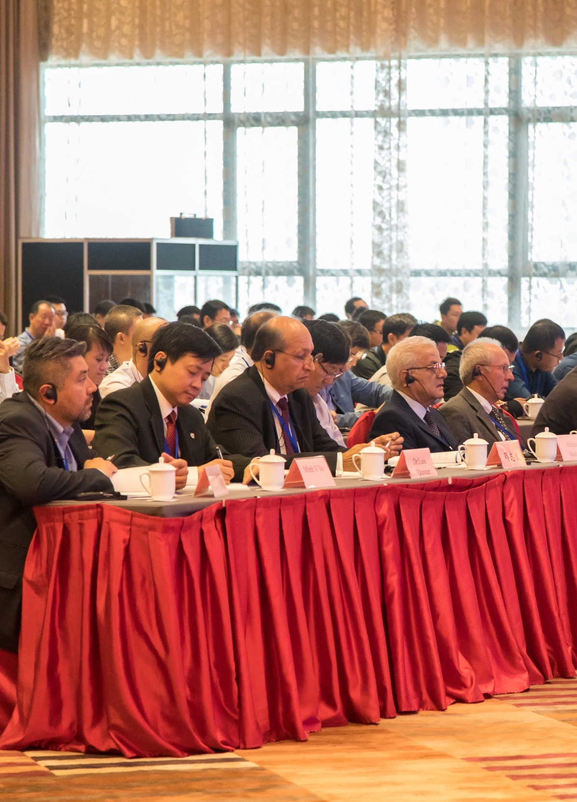
2
Exhibition IFEDC
>>>

Slide 11
Exhibition at IFEDC
Charge Standard
Booth | Standard Booth 3m×3m | Special Booth 3m×6m
Price | USD 3,200 each | USD 5,760 each
Note： 1. Each booth package includes: three-sided (or two-sided) exhibition board, one negotiating table ,two negotiating chairs, general lighting, a 220V/5A power socket and Fascia board of company name. 2. There is 1 complimentary exhibitor to attend the conference, with admittance to the exhibition, luncheons and opening ceremony. 3. Exhibit space is assigned on a first-come, first-served basis. This will Be paid at 10% discount before 30 June 2026. 4.The discount will be 30% before 31 December 2025, 20 % before 31 March 2026 and 10% before 31 June 2026. and the discount is 10% for previous exhibitors.

Slide 12
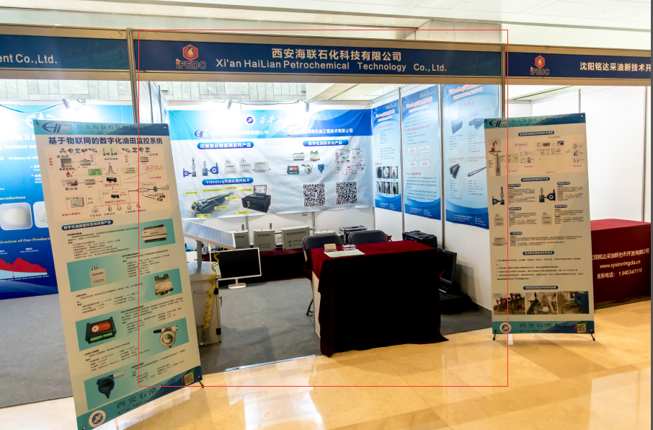
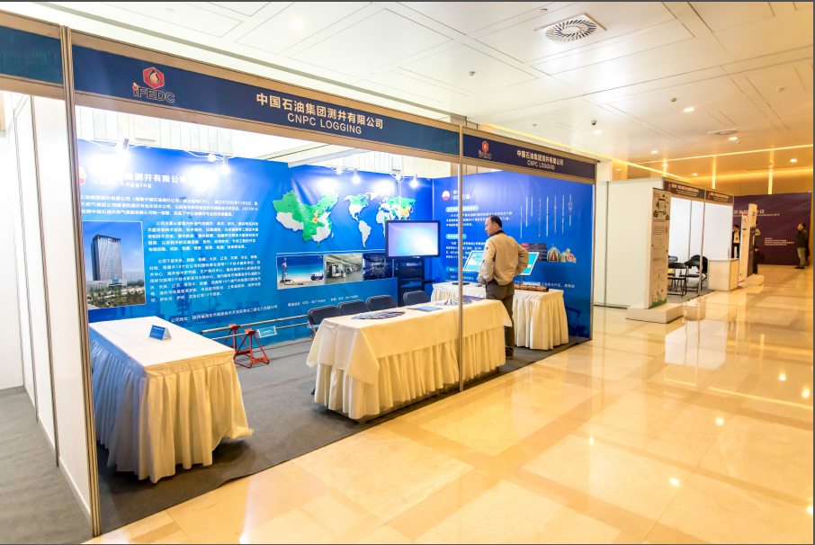
Exhibition at IFEDC
Booth Cases
Standard Booth 3m×3m
Special Booth 3m×6m

Slide 13
Exhibition at IFEDC
Previous List
1 | Schlumberger Company
2 | Halliburton Company
3 | Weatherford International Ltd.
4 | China Corelab Ltd.
5 | Energy Science Service & Consulting Associates(ESSCA)
6 | CNPC Logging (CPL)
7 | Bureau of Geophysical Prospecting INC.CNPC
8 | Winzoner Technology (Shanghai) Limited
9 | Beijing Union Science & Technology Development Corp. Ltd
10 | Xi'an Hailian Petrochemical Technology Co., Ltd.
11 | Carl Zeiss (shanghai)
12 | Sanying Precision Instruments Co., Ltd
13 | Pioneer Sinopetroleum(Bejing) Equipment Ltd.
… | More

Slide 14
3
Sponsorship Program
>>>

Slide 15

Sponsorship Program
1
Principal Sponsor (only 1)
2
Welcome Reception Sponsor（only 1）
3
Lunch Sponsor（only 2）
Sponsor
4
Coffee Break Sponsor （only 4）
5
Excellent Paper Award Sponsor（only 1）
6
U Disk Sponsor（only 1)
All sponsor items can enjoy:
The discount will be 30% before 31 December 2025, 20 % before
31 March 2026 and 10% before 31 June 2026.

Slide 16
Sponsorship Program
Principal Sponsor (only 1)：USD30000
1 | Your company’s name will be on every background as Principal Sponsor at 2020 IFEDC, such as Opening Ceremony, Registration, Best Paper Award Ceremony and so on.
2 | Eight(8) full conference registrations for your company personnel.
3 | Your company’s logo will be featured on IFEDC website with a hyperlink to your x company’s website for one(1) year；
4 | Two (2) roll screens at the Registration (created by sponsoring company).
5 | Two (2) full-page color advertisement about your company in the Conference Guide (created by sponsoring company).
6 | Logo and name of your company will be printed on every attendee’s delegate card.

Slide 17
Sponsorship Program
Principal Sponsor (only 1) ：USD30000
7 | Your company’s publicity material is allowed to be put in conference handbag for every attendee(created by sponsoring company).
8 | Acknowledgement at the Opening Ceremony.
9 | Video Advertisement exceeding 40 seconds will be played during t he coffee break at every session (created by sponsoring company).
10 | Two (2)oral presentations will be arranged for your company during the conference.
11 | IFEDC would like to recommend some key customers to your company.
12 | There will be a special report for IFEDC in China Petroleum Daily, and it will be reported by more than 30 professional medias at the same time.

Slide 18
Sponsorship Program
Welcome Reception Sponsor (only 1)：USD18000
1 | Your company’s name will be on Welcome Reception background at 2020 IFEDC
2 | Five(5) full conference registrations for your company personnel.
3 | Your company’s logo will be featured on IFEDC website with a hyperlink to your x company’s website for one(1) year
4 | One (1) full-page color advertisement about your company in the Conference Guide (created by sponsoring company).
5 | A speech about 5 minutes for you to introduce your company at the Welcome Reception
6 | There will be a special report for IFEDC in China Petroleum Daily, and it will be reported by more than 30 professional medias at the same time.

Slide 19
Sponsorship Program
Lunch Sponsor (only 2)： USD10000 for 1 day
1 | Your company’s publicity material(only 1 page) is allowed to be put in conference handbag for every attendee(created by sponsoring company).
2 | Three(3) full conference registrations for your company personnel.
3 | Your company’s logo will be featured on IFEDC website with a hyperlink to your company’s website for one(1) year.
4 | One (1) full-page color advertisement about your company in the Conference Guide (created by sponsoring company).
5 | A speech about 5 minutes for you to introduce your company at the lunch time.
6 | There will be a special report for IFEDC in China Petroleum Daily, and it will be reported by more than 30 professional medias at the same time.

Slide 20
Sponsorship Program
Coffee Break Sponsor （only 4）： USD2500 each time
1 | Your company’s publicity material(only 1 page) is allowed to be put in conference handbag for every attendee(created by sponsoring company).
2 | One (1) full conference registrations for your company personnel.
3 | Your company’s logo will be featured on IFEDC website with a hyperlink to your company’s website for one(1) year.
4 | One (1) full-page color advertisement about your company in the Conference Guide (created by sponsoring company).
5 | Two (2) roll screens at the coffee places (created by sponsoring company).

Slide 21
Sponsorship Program
Excellent Paper Award Sponsor： USD6000
1 | Your company’s leader(only 1) will be invited to be as presenter at the Excellent Paper Award, and named with your company.
2 | Two (2) full conference registrations for your company personnel.
3 | Your company’s logo will be featured on IFEDC website with a hyperlink to your company’s website for one(1) year.
4 | One (1) full-page color advertisement about your company in the Conference Guide (created by sponsoring company).
5 | Two (2) roll screens at the coffee places (created by sponsoring company).
6 | Acknowledgement at the Excellent Paper Award Ceremony.
7 | Your company’s publicity material(only 1 page) is allowed to be put in conference handbag for every attendee(created by sponsoring company).

Slide 22
Sponsorship Program
U Disk Sponsor : USD2500 each time
1 | Your company’s publicity material (less than 100MB)is allowed to be put in a U disk and the U disk will be in conference handbag for every attendee(created by sponsoring company).
2 | One (1) full conference registrations for your company personnel.
3 | Your company’s logo will be featured on IFEDC website with a hyperlink to your company’s website for half(0.5) year.
4 | One (1) full-page color advertisement about your company in the Conference Guide (created by sponsoring company).

Slide 23

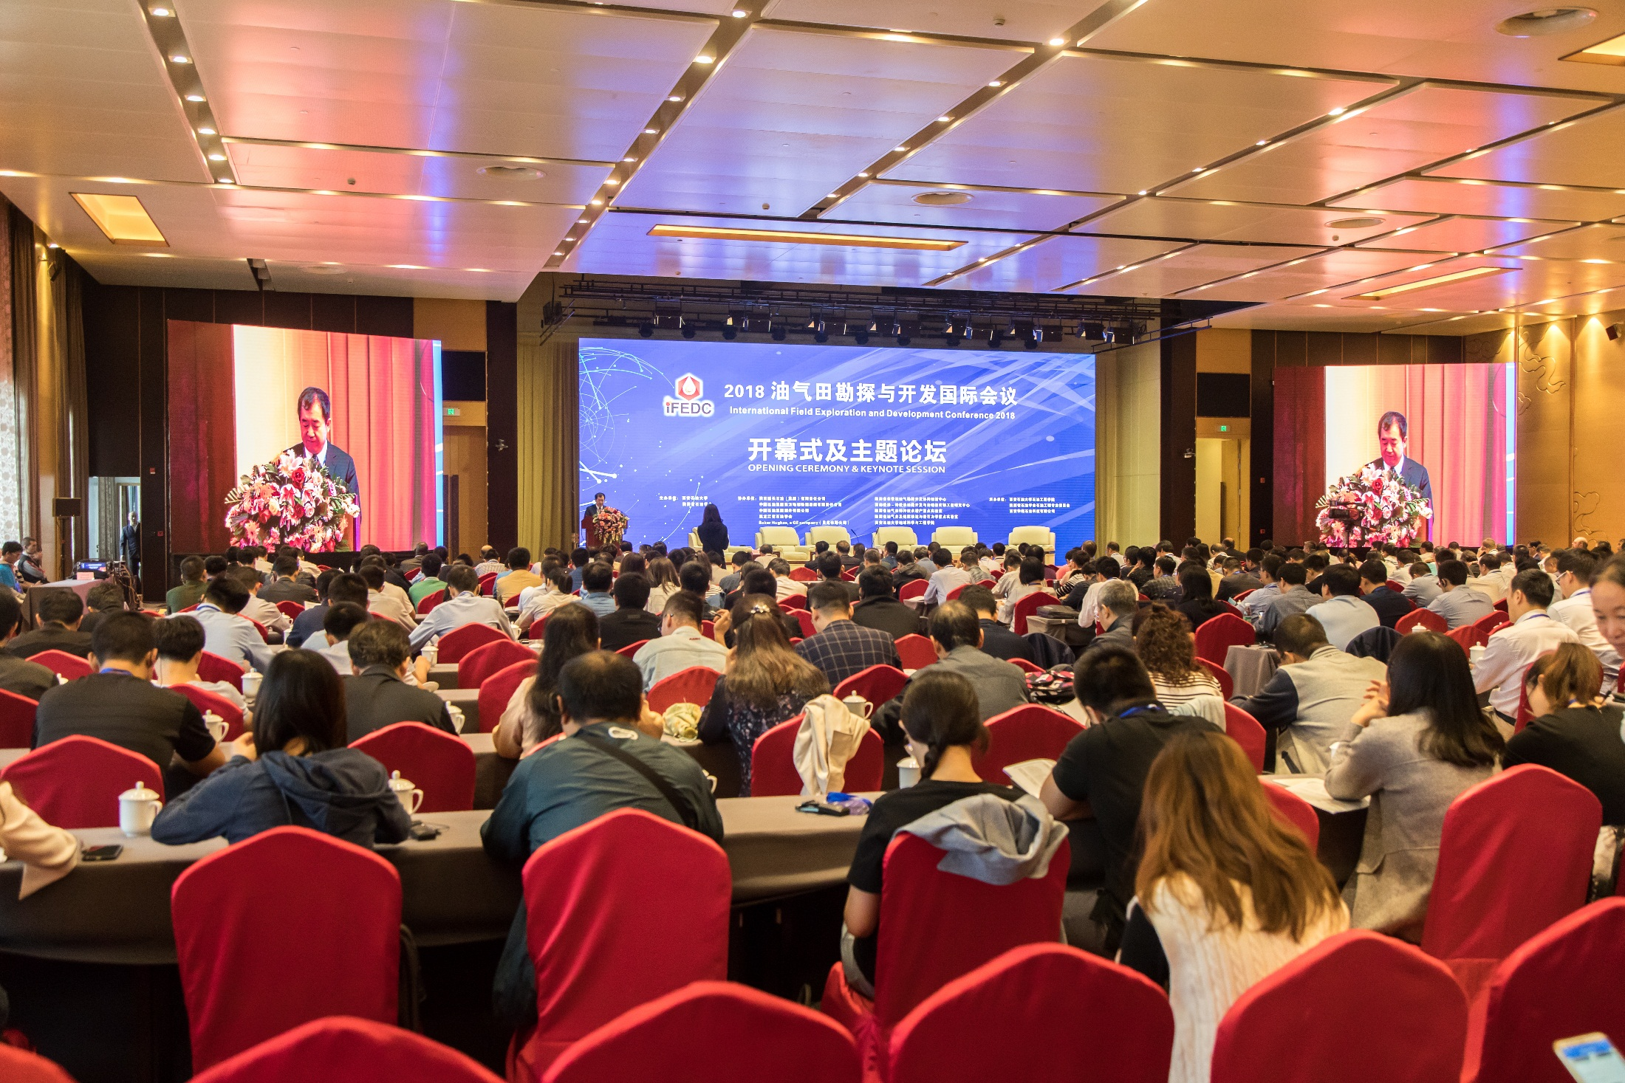
油气田勘探与开发国际会议
International Field Exploration and Development Conference
Thank you for your attention and recognition
大会官网：http://www.ifedc.org/

